Slide 1
Creating a smart field workforce with an
AI-powered video guide *
Credits
Richard Abraham | Sabharinath S | Deesha Chaware
* The development of the solution with the AI-assisted video guide and the Recommendation Engine is a collaborative effort in partnership with Vyntelligence.

Slide 2
Field service providers are constantly striving to improve efficiency, reduce the number of site visits and improve customer experience
Field service inefficiencies lead to increased costs
Field service organizations in the connectedness industry can improve efficiency by leveraging the power of video for capturing rich information, intelligence, and insights.
Service calls require one or more field visits
Video capture – Move away from error-prone, time-consuming and manual capturing of data to avoid re-visits. Video technology can capture the nuances of the site easily and accurately.
Remote audits – Avoid sending an auditor physically after every install. Video intelligence can enable remote audits and save time, effort, and cost.
AI-based video guide – Simplify field engineers’ work and implement ‘right-first-time’ culture. Video intelligence can enable capturing 100% required data sparing multiple site visits for field engineers.
25%
Increase in repair costs due to poor installation, repeat site
visits, etc.
40%
5X
Service orders are delayed
Source- Aberdeen’s Report
The insight elaborates on how to leverage Video AI to decrease installation quality issues by 60%, reduce repeat site visits,
and shorten order-to-delivery time.

Slide 3






Build an AI-powered video intelligence framework to transform field operations, creating smart field workforce
Traditional field service approach (Sample use case – Site survey)
Proposed AI-powered video intelligence framework
New install order
High level design and schedule of survey
Video Intelligence Framework
New install order
Work-order details provided
Provide work order to the surveyor
Surveyor goes to the field
Send to installation
Surveyor leverages the framework to capture all details through a guided tour
Storyboard to capture survey video
Auto-capture specific details using NLP & AI
Note specific details including poles, ducts, chamber guidelines
Mark specific details to access; traffic management; Wayleave, etc.
Input the manually captured details to the portal/send via email
Submits survey successful
Auto-check on compliance & missing details
Send to installation
Store survey video for future reference & Remote audit
Change in design/plan owing to any issue
OR
Any incorrect/ missing details
Surveyor captures all the required survey details manually on a paper and later re-enters them in a portal. For any incorrect or missing detail, the surveyor again goes back to conduct the survey. This approach has various limitations:
Surveyor captures a video and voices it over through a guided storyboard. The framework auto-captures the details using NLP and AI and sends alerts for missing details. Survey is submitted with 100% details and can be a point of reference for specific details or future changes. Advantages are:
Time-consuming
Manual
Error-prone
Repetitive
Improved FTFR
Reduced MTTR
Improved NPS
OpEx savings
Improved technician efficiency
The image above illustrates the use of AI-powered video intelligence framework in ‘site survey’. The framework also supports other field service use cases such as installations, repairs, etc.

Slide 4



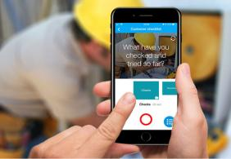


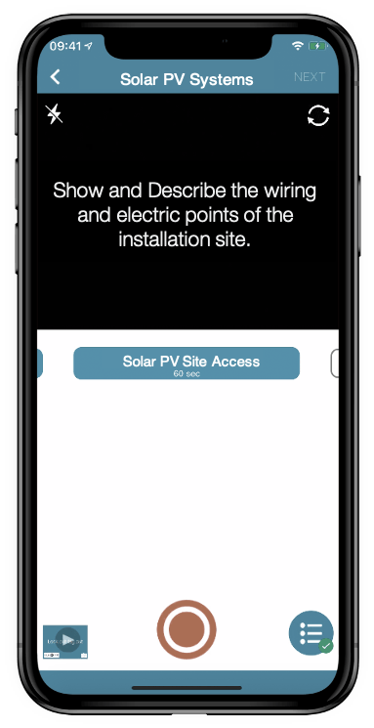
Key components of the AI-powered video intelligence framework which streamline the field services
Reduce OpEx through 'right-first-time’ fieldwork, and enhance customer experience through reduced 'time-to-resolve'
AI-assisted Video Guide
Recommendation Engine
Smart Dashboards
Enables the field engineer to capture a guided video based on a predefined storyboard
Provides AI-powered recommendations and real-time visibility of all the jobs to the supervisors, auditors and field engineers
Provides end-to-end visibility on jobs driving smarter actions for Service delivery managers and Auditors
AI-powered Intelligence Framework can transform field operations through storyboards, guided actions, and intelligent dashboards leading to 3x acceleration in installation time and improved customer experience.

Slide 5

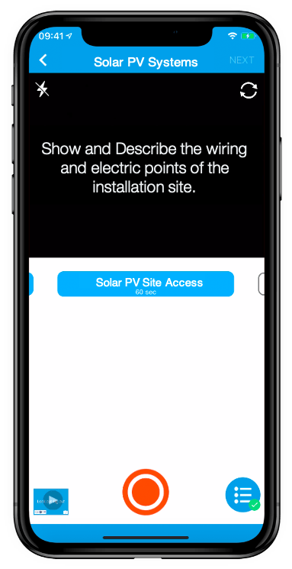
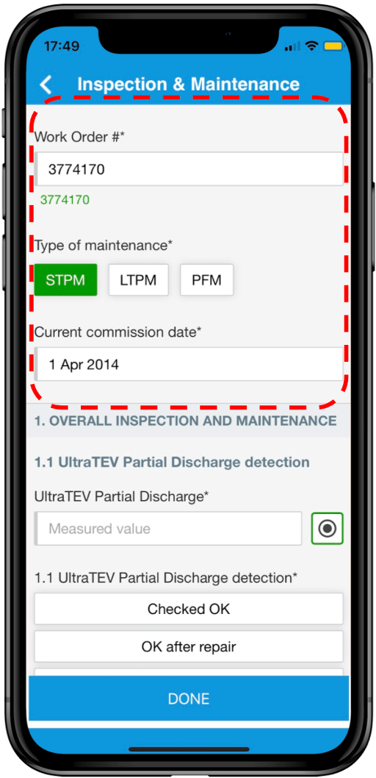
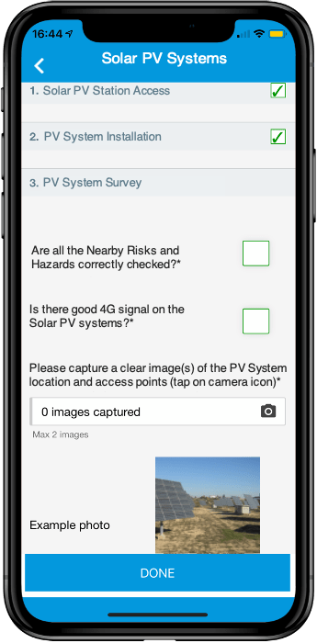



AI-assisted Video Guide – Effortlessly capture field data with a prescriptive storyboard
Enables field engineers to capture guided videos with predefined storyboards, and reduce repeat visits
Perform these crucial steps to create an accurate storyboard for video guide
Video Capturing
Image Capturing
Dynamic Workflows
Automated capturing
Analyze AS-IS
Simple, prescriptive short video capturing
Prescriptive image capturing with benchmark images and annotation capability
Dynamic workflows with auto-populated fields and nested checklists capability
Capture OCR/Barcode/ Meter readings automatically with intelligent range checks
Use process consulting to understand the AS-IS process in detail. Understand the role of field engineers, the data collected, and the resolution provided.
Use process re-engineering to define the ‘To-Be’ process.
Create storyboards
Based on the use-cases identified to capture inputs, create and design storyboards & segments.
Dynamic workflows built with low-code platforms and built-in computer vision technology identify objects in the video and auto-capture them with relevance.
Recommendations
Leverage video-enabled and structured data capture inputs digitally, to enhance and replace manual/text form fields
Drive higher compliance and productivity with easy narration and consistent NLP tuning
Ensure better end-to-end process mgmt., timely interventions, and eliminate missing steps with Planned and guided storyboards

Slide 6


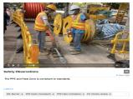

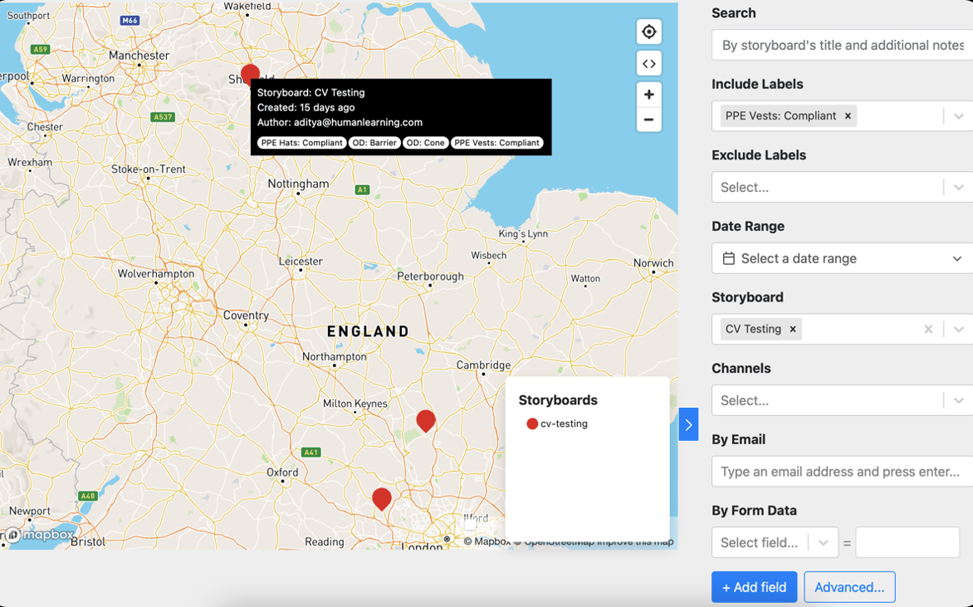
Recommendation Engine – Leverage guided actions powered by Intelligent Platform
Provides AI-powered recommendations and real-time visibility into the jobs to supervisors, auditors and field engineers
Enable field engineers
Enable supervisors
Enable auditors
Field engineers get auto-alerts if they miss capturing any details. In case of any challenges or roadblocks, engineers can access a repository of articles for quick guidance.
Remote view of the status and activities performed within the jobs is provided to supervisors. This enables job location tracking and remote allocation of jobs.
Auditors have access to videos for performing remote audits. These videos being auto tagged with annotated images, provide details about real issues and solution performed.
AI-powered Auto Alerts
Real time job monitoring
Auto-tagging
Work details appear on the supervisor and the field engineer's app
Auto tagged & annotated images or videos are captured by your workers to help you communicate without being there
Able to annotate and comment on visuals to ease handovers/ collaborate and track actions using the resulting searchable knowledge base
Map-based search from the dashboard
Annotation & Intelligent Alerts
Real time job location (geo-spatial) map provides remote command and control to track & progress jobs, track field technicians’ job location and allocate jobs based on their locations
The field technician can voiceover and auto-tag while capturing the video. Video-to-text conversion enables text searchability in the video
Searchable index
Searchable indexed know-how articles relevant to the job to guide engineers in case of any queries
Recommendations
Provide automated alerts and leading indicators for rapid action by the right person at the right time
Use geolocation map-based interface and intuitive dashboards to track, analyze, and complete the job
Utilize AI-powered computer vision & natural language processing, video search, and trends from the analysis of qualitative data, for enabling effective remote audits

Slide 7

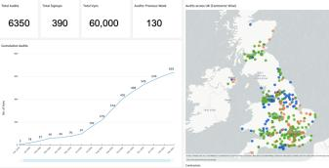
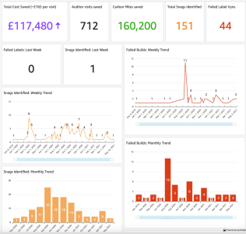
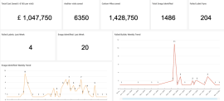
Smart Dashboards – Leverage Intelligent Reports and
Dashboards to drive smart decision making
Provides end-to-end visibility of jobs, driving smarter actions for management and business as a whole
Smart Dashboards can spot trends, predict actions and offer recommendations. Executive decisions like provisioning equipment, sending the right teams and obtaining the right permissions can be completed faster, with greater accuracy.
Gain insights through leading indicators for preventive action and optimal mobilization of workforce
Easily monitor cost savings, site visits/audits, and environmental friendliness stats
Use the Dashboard to View how work is progressing and configure it to show the relevant KPIs that you need to succeed

Slide 8
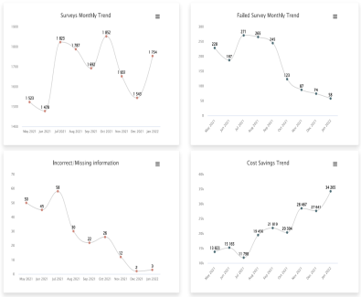
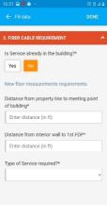
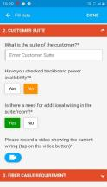
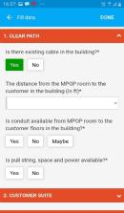
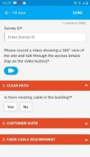
A leading service provider in North America implemented AI-powered video intelligence framework
Improved field service efficiency and accelerated fibre products order to delivery time by 41%
Capturing field details using custom-designed storyboard guiding field engineers
Step 4: Enter other problem details
Step 3: Enter customer specifics
Step 2: Record Site Details
Step 1: Record Video
"Illustration: Field service mobile app provides step-by-step guidance to field engineer, to shoot the site video and capture needed data"
Reduction in ‘failed survey trend’ implies significant improvement in the first-time fix rates and associated cost savings. For e.g., in Jan 2022, out of 1754 surveys performed only 58 failed

Slide 9

Business benefit achieved by a leading service provider in North America by building & implementing an AI-powered video intelligence framework
3X
90%
Acceleration of Install to Commission cycle time
Less failed handovers due to digitization
60%
30%
Reduction in field data quality snags/issues
Cost-savings across the field operations

Slide 10
Thank you
insights@prodapt.com

